Slide 1
3D Grid (Voxel) Based Planning Construction Sequencing for Industrial Modules
Introduction: This project presents a 3D voxel-based approach to generate construction sequences from 3D models, where the work sequence is planned based on spatial positioning and construction rules—such as dependency (e.g., foundation before superstructure, column before beam) and constructability constraints related to discipline or trade-specific sequencing.
Objective:
To generate a construction sequence based on voxelized spatial data and construction rules, which can be utilized as environment for an intelligent agent to learn construction planning and execution.

Slide 2
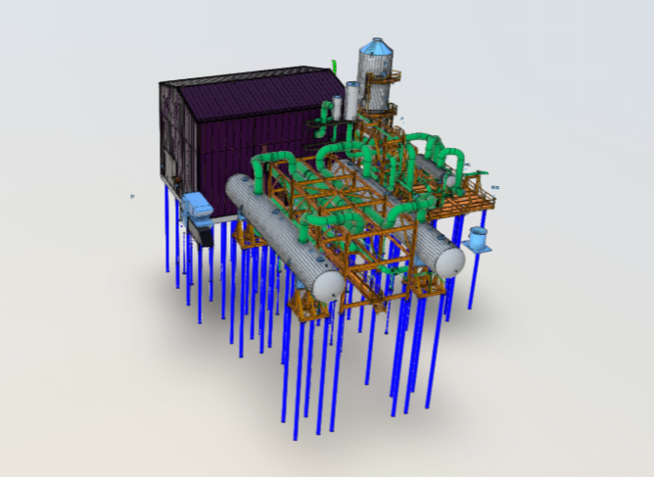
Methodology Overview
An industrial module represented by a 3D IFC model (1A03.ifc) is used as the basis for voxel-based analysis.
The entire module is discretized into uniform 3D voxels of size 10m × 10m × 10m. Each voxel is labeled as Vx(x, y, z), where x, y, and z represent the voxel’s index in the spatial grid (ranging from 0 to 4 along each axis).
A total of 100 voxels (5 × 4 × 5) define the volume of the module. Among these, 51 voxels contain components, while the remaining are empty.
Components are assigned to voxels based on their location extracted from IFC spatial data, and their mapping is stored in a structured CSV file (components_with_voxels.csv). https://drive.google.com/drive/u/0/folders/1S3DJDPSHB1W0KvQHFbMGDghg6HyWzT0h

Slide 3
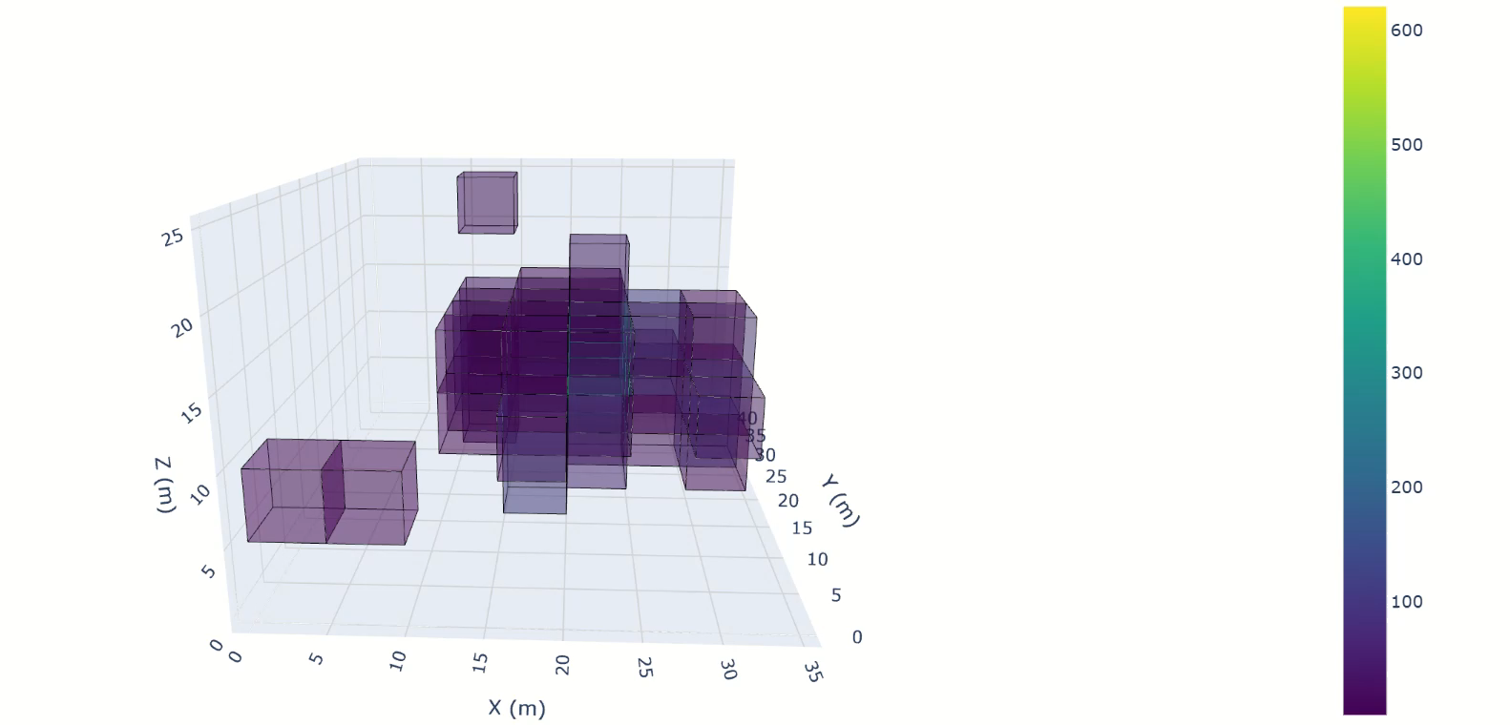

Slide 4
Methodology Overview
Manual Sequencing
To generate the construction sequence: The 51 populated voxels out of total 100 voxels are considered (Sequence_Work-VER03.csv ). 53 voxels are empty.
Manual sequencing is determined based on support requirements (e.g., gravity/stability) and trade or discipline-based constraints (e.g., structure before mechanical or piping). A component is assumed to be concentrated its location ( though physically it may extend in other adjacent voxels).
See the links for details: Sequence_Work_03JN.csv https://drive.google.com/drive/u/0/folders/1f-SUf4QXO5eH0igOizmKHSiSYUFBbW6E
For each voxel, total man-hours are estimated (here a random lump sum value) based on its component configuration.
Man-Hour Estimation and Progress Tracking
For each voxel, total man-hours are calculated based on the types and quantities of components it contains.
A weekly construction capacity threshold (i.e., a cap on man-hours per week) need to be defined. Using this constraint, weekly progress can be evaluated by:
Tracking the number of completed voxels after each week
Reporting partial completion based on percentage of work done
Visually displaying construction status in both physical and volumetric terms

Slide 5
Limitations of the Current Approach
Missing data in IFC Model: The IFC model does not explicitly provide component names, descriptions, or trade classifications, making accurate data mapping challenging. As a result, a highly manual and visually guided approach using the 3D model was required for interpretation.
Voxel Assignment Simplification: Components are assumed to be fully contained within a single voxel, even though many span multiple voxels.
Misrepresented Support Dependencies: Structural dependencies across voxels may be ignored, leading to incorrect sequencing, especially for load-bearing elements.
Arbitrary Man-Hour Estimates: Man-hours are assigned as lump-sum values without considering actual work volume, productivity data, trade-specific labor rates, or component complexity.
Limited Reliability: Due to the above factors, the model lacks accuracy for progress tracking, scheduling, and resource planning.

